Slide 1
The Nearest Neighbor rule (KNN) & Logistic Regression Session 17 & 18
Course : COMP6577 – Machine Learning
Effective Period : December 2019

Slide 2
Learning Outcome
LO3: Student be able to experiment classification and clustering algorithm from given dataset

Slide 3
Outline
Bayesian Vs K-NN
The Nearest Neighbor rule
Example of KNN
Logistic regression
Multiclass logistic regression
Case Study

Slide 4
Bayesian Vs K-NN
Bayesian rule provides the optimal solution with respect to the classification error probability, but its application requires the estimation of the respective conditional pdfs; which is not an easy task, once the dimensionality of the feature space assumes relatively large values.
The k-nearest neighbor (k-NN) rule is a typical nonparametric classifier and it is one among the most popular and well-known classifiers.
In spite of its simplicity, it is still in use and stands next to more elaborate schemes.

Slide 5
The Nearest Neighbor Rule
Consider N training points, (y_{n},x_{n}), n=1,2,...,N, for an M-class classification task. At the heart of the method lies a parameter k, which is a user-defined parameter. Once k is selected, then given a pattern, x, assign it to the class in which the majority of its k nearest (according to a metric, e.g., Euclidean or Mahalanobis distance) neighbors, among the training points, belong.
The parameter k should not be a multiple of M, in order to avoid ties. The simplest form of this rule is to assign the pattern to the class in which its nearest neighbor belongs, meaning k=1.

Slide 6
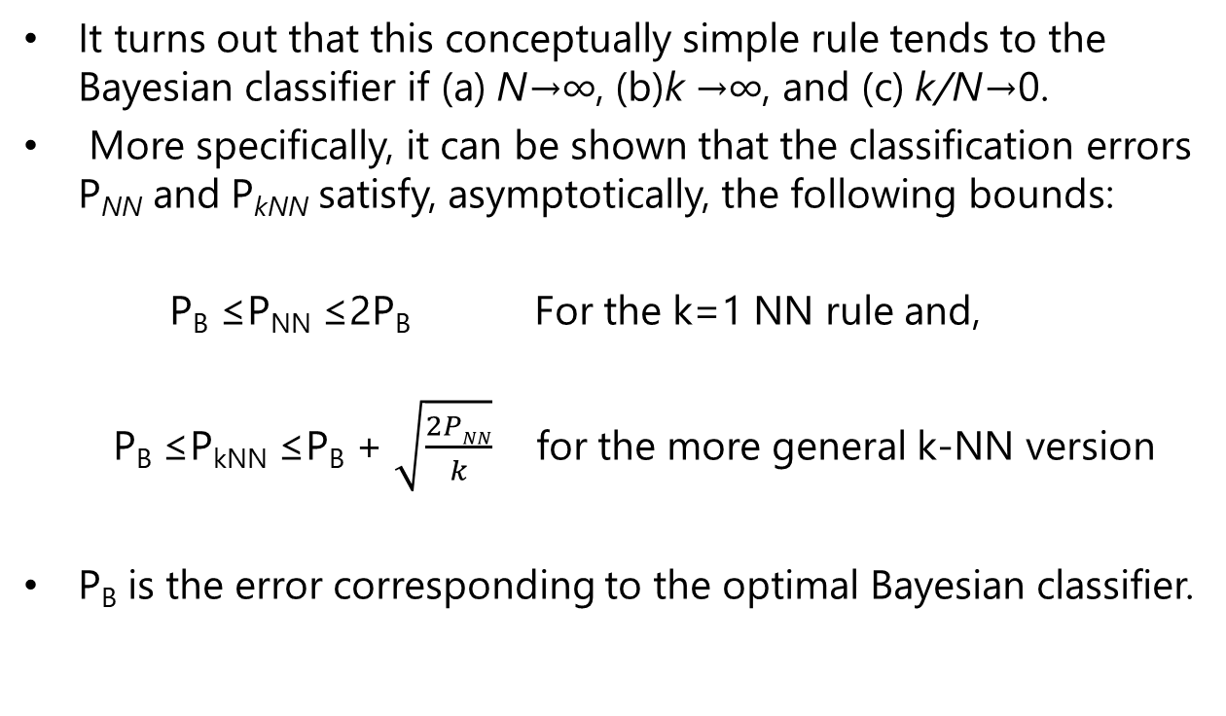
The Nearest Neighbor Rule (2)
It turns out that this conceptually simple rule tends to the Bayesian classifier if (a) N→∞, (b)k →∞, and (c) k/N→0.
More specifically, it can be shown that the classification errors P_{NN} and P_{kNN} satisfy, asymptotically, the following bounds:
P_{B} ≤P_{NN} ≤2P_{B} For the k=1 NN rule and,
P_{B} ≤P_{kNN} ≤P_{B} + $\sqrt{\frac{2PNN}{k}}$ for the more general k-NN version
P_{B} is the error corresponding to the optimal Bayesian classifier.

Slide 7
By those two formulae, if one has an easy task (as indicated by the very low value of PB), the NN rule can also do a good job. This, of course, is not the case if the problem is not an easy one and larger error values are involved.
The bound in the second formula says that for large values of k (provided, of course, N is large enough), the performance of the k-NN tends to that of the optimal classifier. In practice, one has to make sure that k does not get values close to N, but remains a relatively small fraction of it.

Slide 8
The Bayesian classifier exploits the statistical information for the data distribution while the k-NN does not take into account such information.
The reason is that if N is a very large value (hence the space is densely populated) and k is a relatively small number, with respect to N, then the nearest neighbors will be located very close to x.
Due to the continuity of the involved pdfs, the values of their posterior probabilities will be close to P(ωi|x), i = 1, 2, ... , M.
For large enough k, the majority of the neighbors must come from the class that scores the maximum value of the posterior probability given x.

Slide 9
Drawback
Every time a new pattern is considered, its distance from all the training points has to be computed, then selecting the k closest to it points.

Slide 10
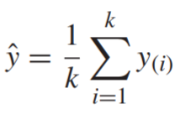
Remarks
The use of the k-nearest rule concept can also be adopted in the context of the regression task.
Given an observation, x, one searches for its k closer input vectors in the training set, denoted as x₍₁₎, ... , x_{(k),} and computes an estimate of the output value, ŷ , as an average of the respective outputs in the training set, represented by

Slide 11
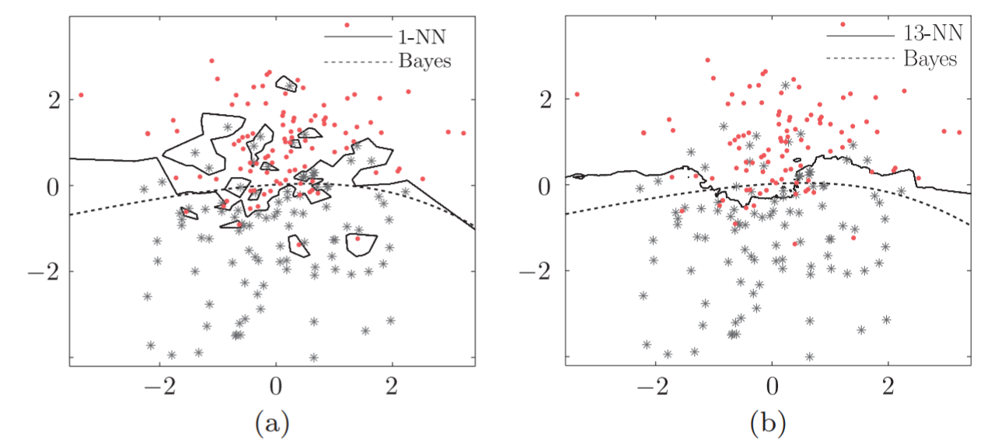
Example
Given an example that illustrates the decision curves for a two-class classification task in the two-dimensional space, obtained by the Bayesian, the 1-NN and the 13-NN classifier.

Slide 12
A number of N = 100 data are generated for each class by Gaussian distributions. The decision curve of the Bayes classifier has the form of a parabola, while the 1-NN classifier exhibits a highly nonlinear nature. The 13-NN rule forms a decision line close to the Bayesian one.
The figure shows a two-class classification task. The dotted curve corresponds to the optimal Bayesian classifier. The full line curves correspond to (a) the 1-NN and (b) the 13-NN classifiers. Observe that the 13-NN is closer to the Bayesian one.

Slide 13
Logistic Regression
In Bayesian classification, the assignment of a pattern in a class is performed based on the posterior probabilities, P(ωi|x). The posteriors are estimated via the respective conditional pdfs, which is not, in general, an easy task.
The goal in this session is to model the posterior probabilities directly, via the logistic regression method.
This name has been established in the statistics community, although the model refers to classification and not to regression.
This is a typical example of the discriminative modeling approach, where the distribution of data is of no interest.

Slide 14
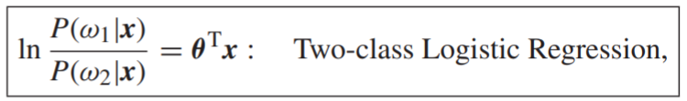
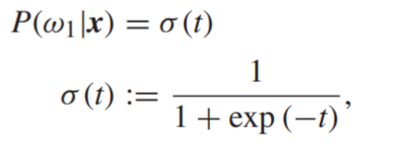
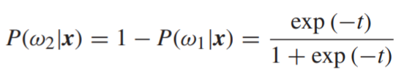
Logistic Regression
The two-class case: The starting point is to model the ratio of the posteriors as
where the constant term, θ₀, has been absorbed in θ. Taking into account that P(ω1|x) + P(ω2|x) = 1, and defining t := θ^{T}x, it is readily seen that the model is equivalent to

Slide 15
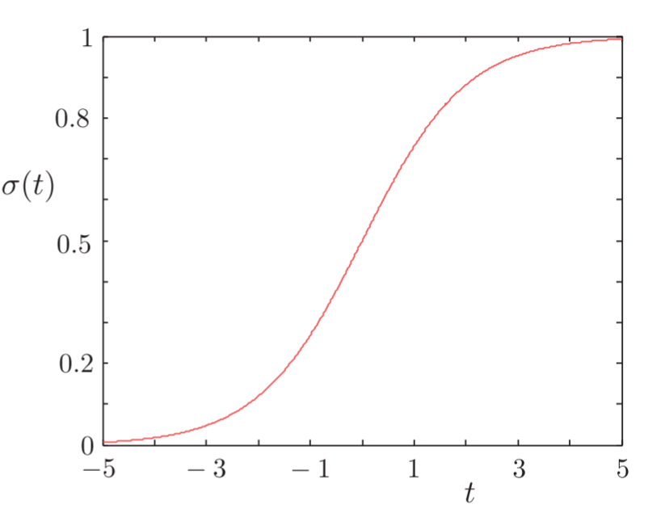
Sigmoid Link Function
The function σ (t) is known as the logistic sigmoid or sigmoid link function and it is shown in the figure.

Slide 16

Logistic Regression
Assuming the data in the classes follow Gaussian distributions with Σ₁ = Σ₂ ≡ Σ and for simplicity that P(ω₁) = P(ω₂), the latter of the previously stated equations is written as
In other words, when the distributions underlying the data are Gaussians with a common covariance matrix, then the log ratio of the posteriors is a linear function. Thus, in logistic regression, all we do is adopt such a model, irrespective of the data distribution.
Moreover, even if the data are distributed according to Gaussians, it may still be preferable to adopt the logistic regression formulation instead of that in the equation above.

Slide 17
In the latter formulation, the covariance matrix has to be estimated, amounting to O(l²/2) parameters. The logistic regression formulation only involves l + 1 parameters.
That is, once we know about the linear dependence of the log ratio on x, we can use this a priori information to simplify the model.
Assuming that the Gaussian assumption is valid, if one can obtain good estimates of the covariance matrix, employing this extra information can lead to more efficient estimates, in the sense of lower variance.
In practice, it turns out that using the logistic regression is, in general, a safer bet compared to the linear discriminant analysis (LDA).

Slide 18
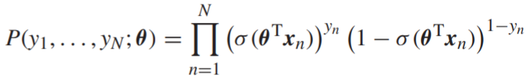
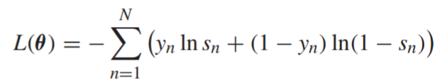
The parameter vector, θ, is estimated via the ML method applied on the set of training samples, (y_{n}, x_{n}), n = 1, 2, ... , N, y_{n} ∈ {0, 1}. The likelihood function can be written as
Usually, we consider the negative log-likelihood given by
where s_{n} := σ (θ^{T}x_{n}).
Also known as
cross-entropy error

Slide 19

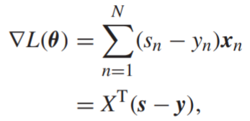
Minimization of L(θ) with respect to θ is carried out iteratively by any iterative minimization scheme, such as the steepest descent or Newton’s method. Both schemes need the computation of the respective gradient, which in turn is based on the derivative of the sigmoid link function:
The gradient is given by
where

Slide 20
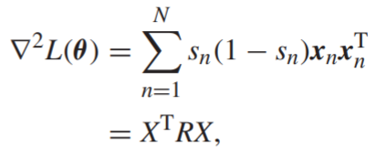

The Hessian matrix is given by
where
Note that because 0 < s_{n} < 1, by definition of the sigmoid link function, matrix R is positive definite; hence, the Hessian matrix is also positive definite.
The negative log-likelihood function is convex, which guarantees the existence of a unique minimum.

Slide 21

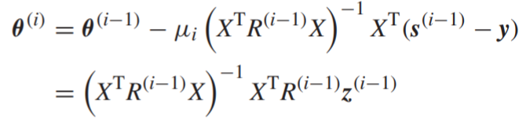

Two of the possible iterative minimization schemes to be used are:
Steepest descent
Newton’s scheme
where
the involved quantities are iteration-dependent and the resulting scheme is known as iterative reweighted least squares scheme (IRLS)

Slide 22
Maximizing the likelihood may run into problems if the training data set is linearly separable. In this case, any point on a hyperplane, θ^{T}x = 0, that solves the classification task and separates the samples from each class (note that there are infinite many such hyperplanes), results in σ (x) = 0.5, and every training point from each class is assigned a posterior probability equal to one.
Thus, ML forces the logistic sigmoid to become a step function in the feature space and equivalently ||θ|| → ∞. This can lead to overfitting and it is remedied by including a regularization term, ||θ||², in the respective cost function.

Slide 23
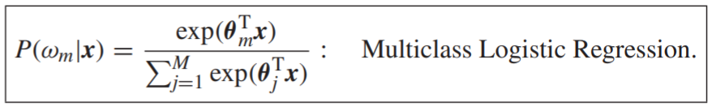
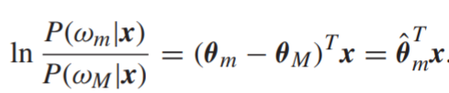
Multiclass Logistic Regression
The M-class case: For the more general M-class classification task, the logistic regression is defined for m = 1, 2, ... , M, as
The previous definition is easily brought into the form of a linear model for the log ratio of the posteriors. Divide, for example, by P(ω_{M}|x) to obtain

Slide 24

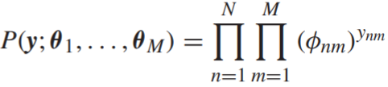
Let us define, for notational convenience,
And
The likelihood function is now written as
where y_{nm} = 1 if x_{n} ∈ ω_{m} and zero otherwise

Slide 25
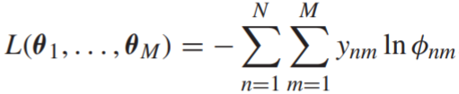

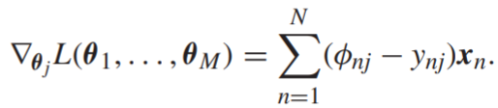
The respective negative log-likelihood function becomes
Minimization with respect to θ_{m}, m = 1, ... , M, takes place iteratively.
The following gradients are used
where δ_{mj} is one if m = j and zero otherwise. Also

Slide 26
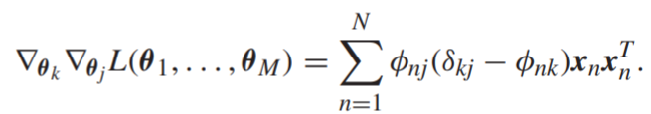
The respective Hessian matrix is an (lM) × (lM) matrix, comprising l × l blocks. Its k, j block element is given by
The Hessian matrix is also positive definite, which guarantees uniqueness of the minimum as in the two-class case.

Slide 27
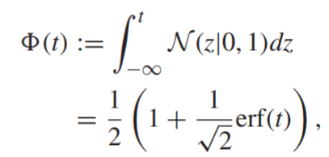
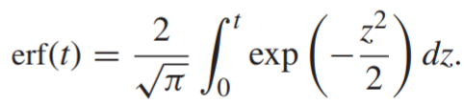
Probit regression
Instead of using the logistic sigmoid function in P(ω1|x) = σ (t) (for the two-class case), other functions can also be adopted. A popular function in the statistical community is the probit function, which is defined as:
where erf is the error function defined as
In other words, P(ω₁|t) is modeled to be equal to the probability of a normalized Gaussian variable to lie in the interval (−∞, t]. The graph of the probit function is very similar to that of the logistic one.

Slide 28
Case Study
Given data of Singapore Airbnb which can be downloaded in this link
https://www.kaggle.com/jojoker/singapore-airbnb
From the downloaded data, try to apply K-NN to classify the data. Discuss the result.
Apply Logistic regression algorithm to do classification for the Singapore Airbnb data above.

Slide 29
End of Session 17 & 18

Slide 30
References
Sergios Theodoridis. (2015). Machine Learning: a Bayesian and Optimization Perspective. Jonathan Simpson. ISBN: 978-0-12-801522-3. Chapter 7.
https://www.kaggle.com/jojoker/singapore-airbnb

